Slide 1
Lecture: Introduction to Computer Vision
Juan Carlos Niebles and Ranjay Krishna
Stanford Vision and Learning Lab

Slide 2
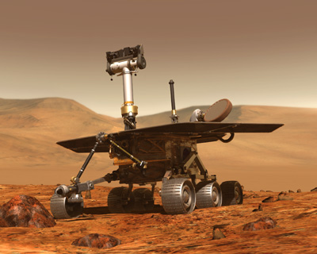
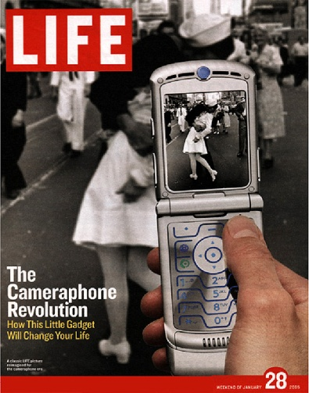
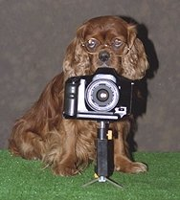
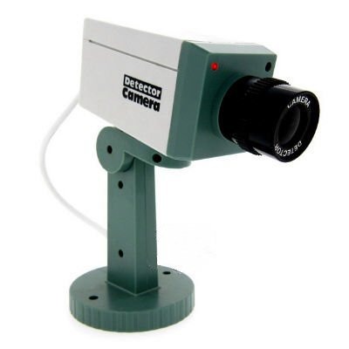
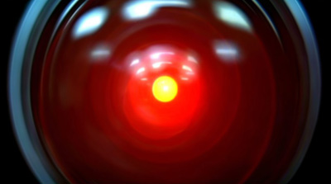
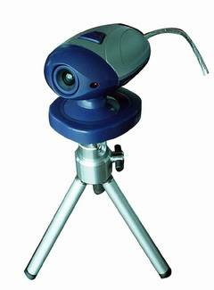
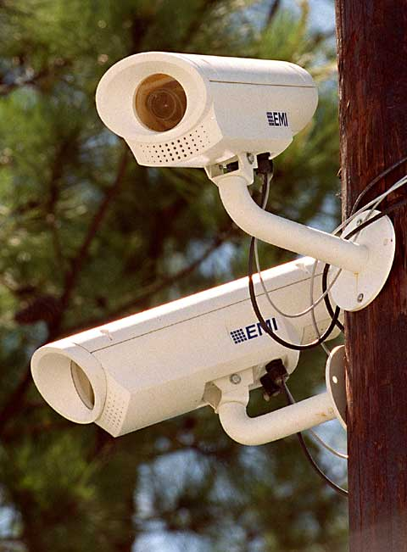
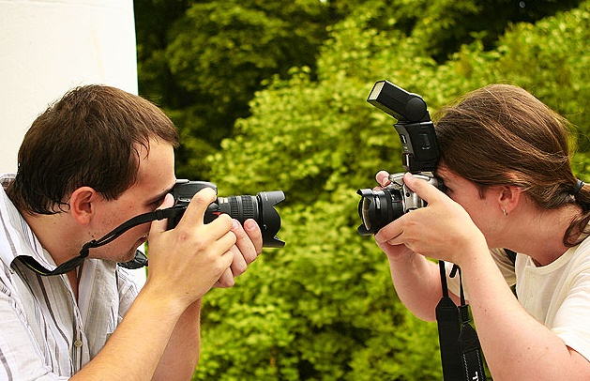
Welcome to CS131

Slide 3
CS131 is the introductory course for computer vision
CS131 (fall, 2017):
Enthusiastic undergrads
Want to get to know this exciting technology
Pre-req to more advanced vision classes
CS231a (winter, 2018, Prof. Silvio Savarese)
Advanced Computer Vision
Seniors, masters, and PhDs
CS231n (spring, 2018): Deep Learning and Convolutional Neural Networks

Slide 4
Biology
Psychology
Neuroscience
Physics
optics
Cognitive
sciences
Computer
Vision
Image
processing
Algorithms,
theory,…
Computer Science
Speech, NLP
Systems,
architecture, …
Robotics
Information
retrieval
Engineering
Machine
learning
Mathematics

Slide 5
Today’s agenda
Introduction to computer vision
Course overview

Slide 6
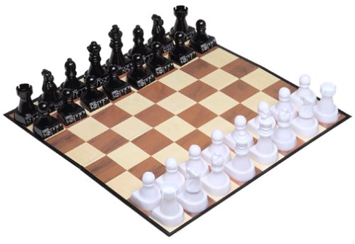

Quiz?
Notes:
Play chess
Deep blue
Or write short poem
poetry

Slide 7
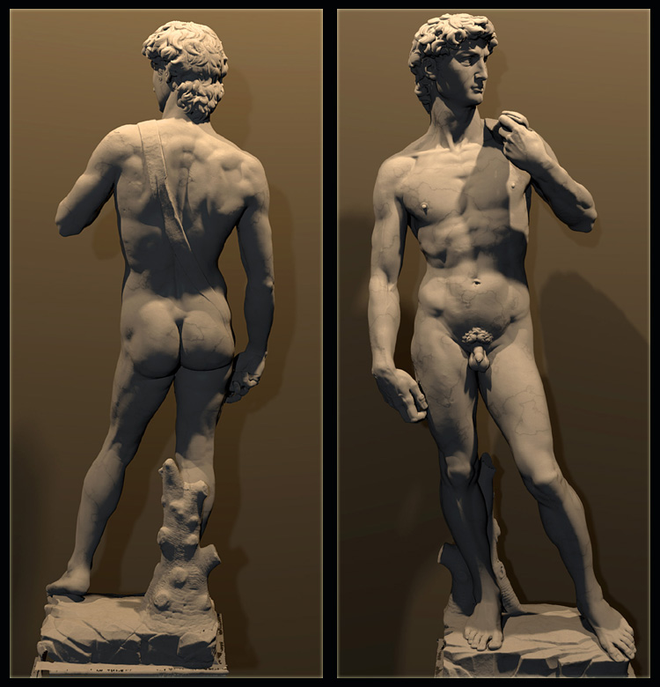
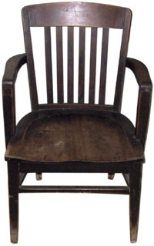
What about this?
Notes:
3d reconstruction vs recognition
What is most difficult task
A mastery best human sculpture

Slide 8
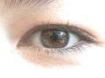

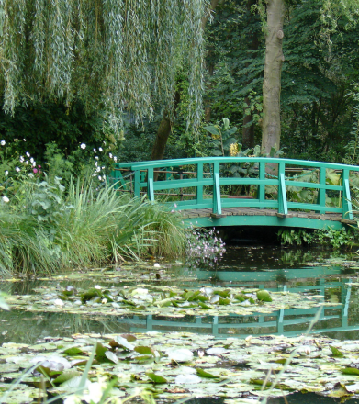
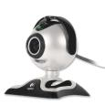
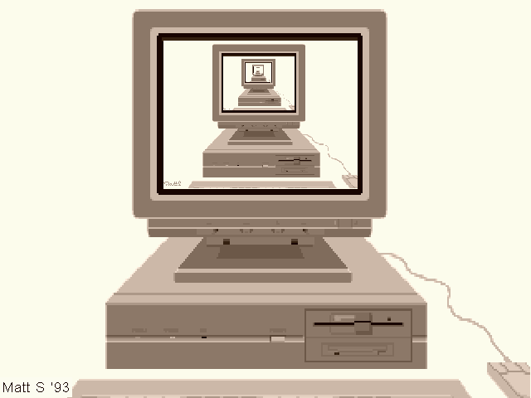
What is (computer) vision?
Image (or video)
Sensing device
Interpreting device
Interpretations
garden, spring,
bridge, water,
trees, flower,
green, etc.

Slide 9
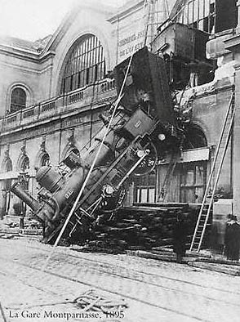
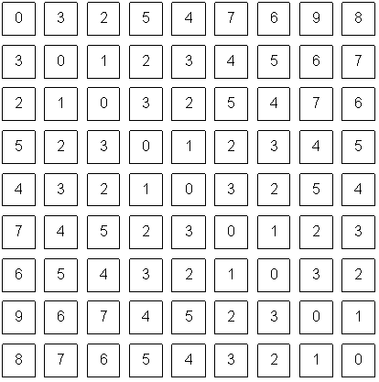
The goal of computer vision
To bridge the gap between pixels and “meaning”
Source: S. Narasimhan
What we see
What a computer sees

Slide 10
What is (computer) vision?
Image (or video)
Sensing device
Interpreting device
Interpretations
garden, spring,
bridge, water,
trees, flower,
green, etc.

Slide 11
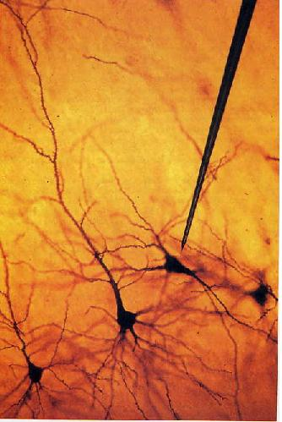
1981: Nobel Prize in medicine
Hubel & Wiesel
Notes:
Human vision
For the first time, recording individual neurons, oriented bars

Slide 12

Human vision is superbly efficient
Potter, Biederman, etc. 1970s
Notes:
Task:
Can u detect a person?
100 ms per frame,
Never seen the picture, do not know the person
Can do effortlessly

Slide 13
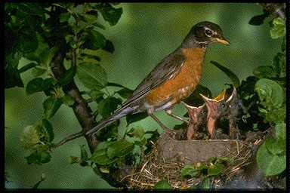
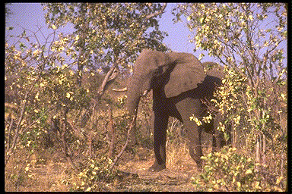
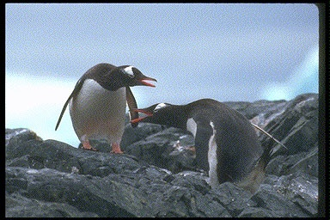
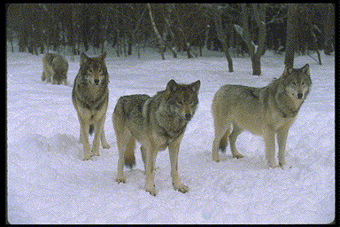
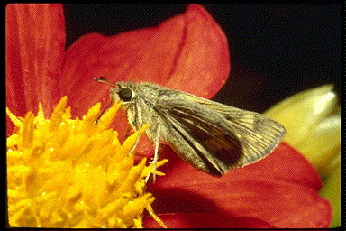
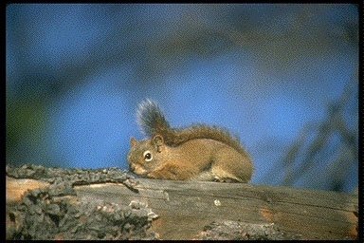
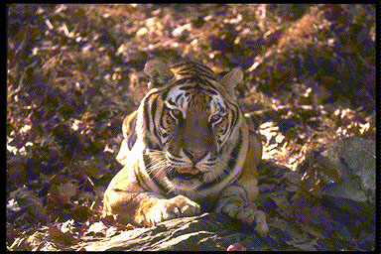
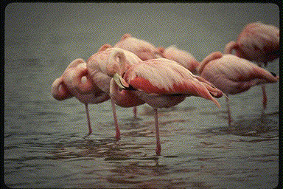
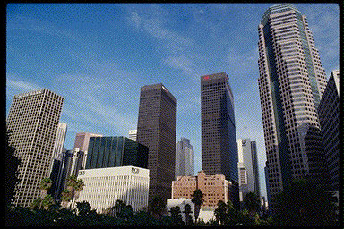
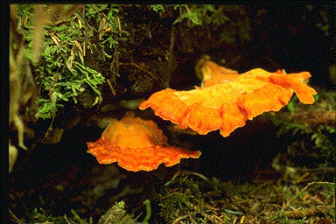
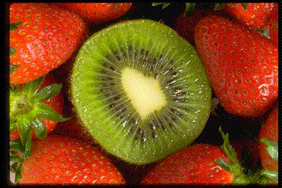
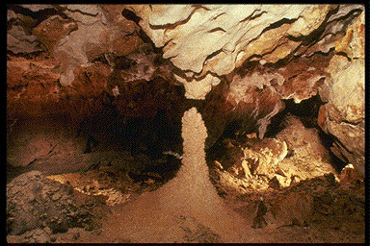
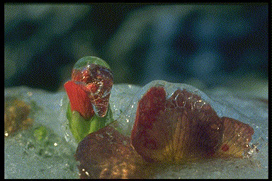
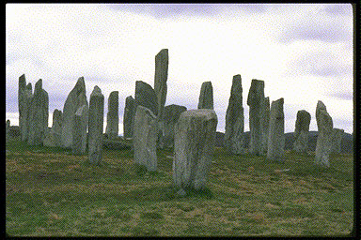
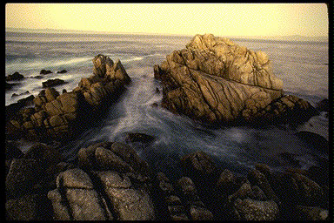
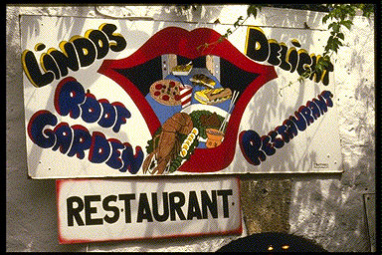
Thorpe, et al. Nature, 1996
Notes:
27ms flash
Very complex pictures – multiple animals, city, textures, etc
Unlike circles in simple background
Task:
Animal vs non animal
Humans do 97%
The most remarkable is next slide

Slide 14
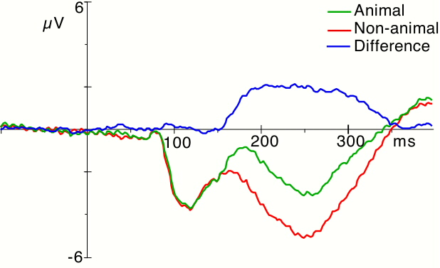
150 ms !!
Thorpe, et al. Nature, 1996
Notes:
Measure brain EEG (electric potential)
Y, voltage /activity
X, 0 is onset from picture
Average all the trials where there is an animal
Red is non animal
Blue is difference
150ms

Slide 15
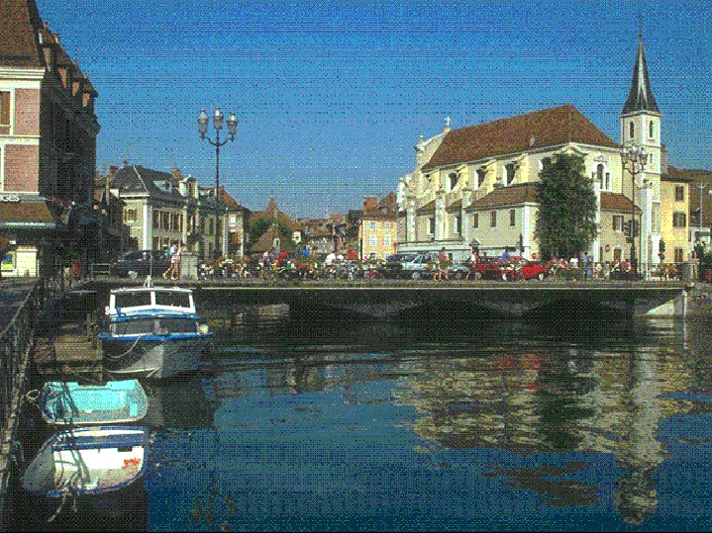
Change blindness
Rensink, O’regan, Simon, etc.
Notes:
Brain is amazing, but is not remarkable not all the time
Two alternating pictures, repeated, different by one thing
Raise when you see it
This one is easy, try another one

Slide 16

Change blindess
Rensink, O’regan, Simon, etc.
Notes:
The signal is in your eyes,
Brain decides to ignore it. Does not process it

Slide 17
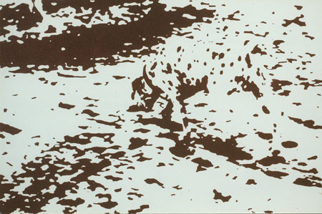
segmentation

Slide 18
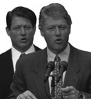
Perception

Slide 19
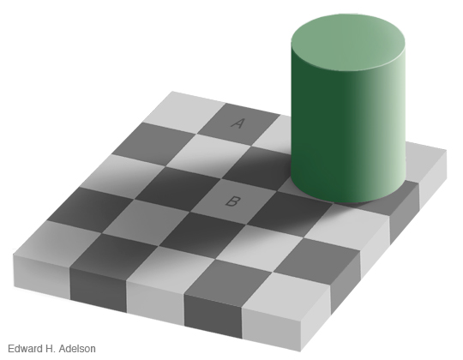

Slide 20

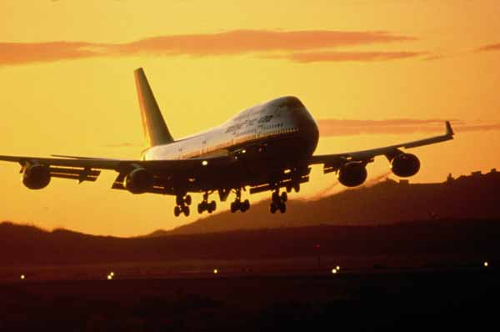

Slide 21
What is (computer) vision?
Image (or video)
Sensing device
Interpreting device
Interpretations
garden, spring,
bridge, water,
trees, flower,
green, etc.

Slide 22
The goal of computer vision
To bridge the gap between pixels and “meaning”
Source: S. Narasimhan
What we see
What a computer sees

Slide 23
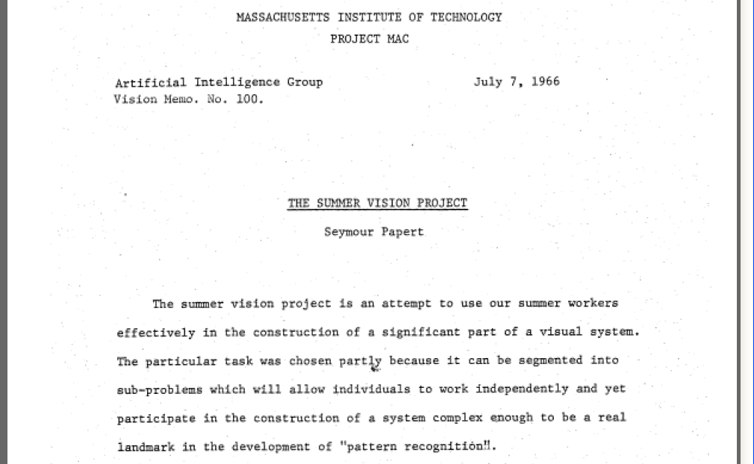
Origins of computer vision: an MIT undergraduate summer project
L. G. Roberts, Machine Perception of Three Dimensional Solids, Ph.D. thesis, MIT Department of Electrical Engineering, 1963.

Slide 24
What kind of information can we extract from an image?
Metric 3D information
Semantic information

Slide 25
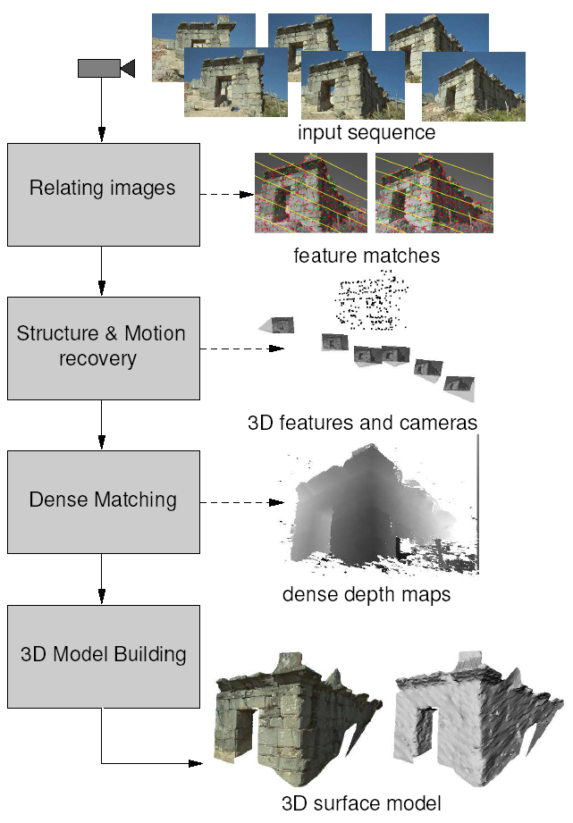
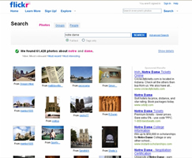
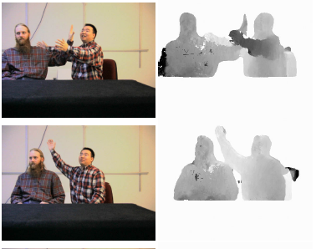
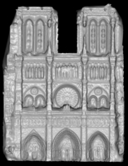
Vision as measurement device
Real-time stereo
Structure from motion
Reconstruction from Internet photo collections
NASA Mars Rover
Pollefeys et al.
Goesele et al.

Slide 26
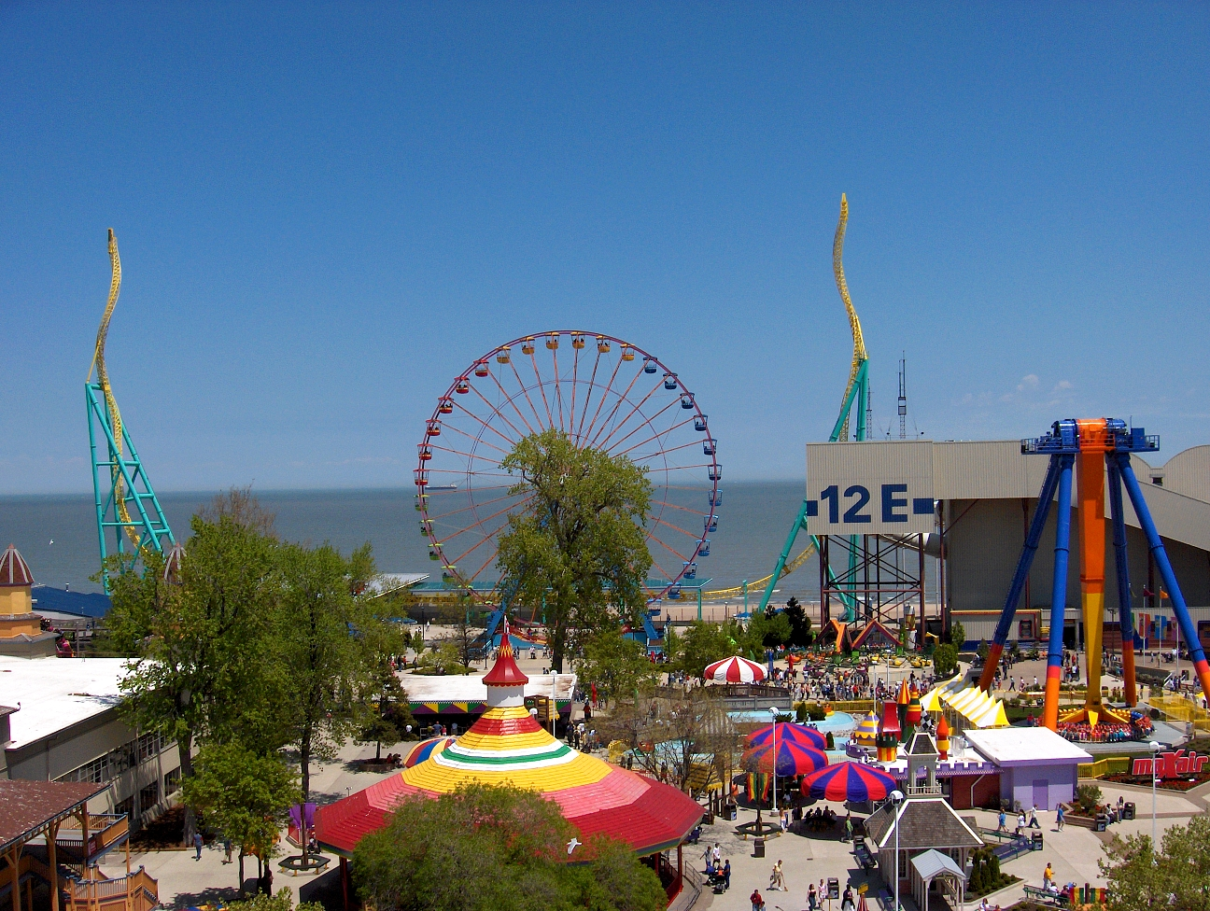
Vision as a source of semantic information
amusement park
sky
Objects
Activities
Scenes
Locations
Text / writing
Faces
Gestures
Motions
Emotions…
The Wicked Twister
Cedar Point
ride
Ferris wheel
ride
12 E
Lake Erie
water
ride
tree
tree
people waiting in line
Slide credit: Kristen Grauman
people sitting on ride
umbrellas
tree
maxair
carousel
deck
bench
tree
pedestrians

Slide 27


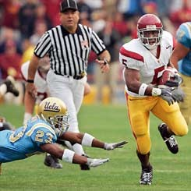
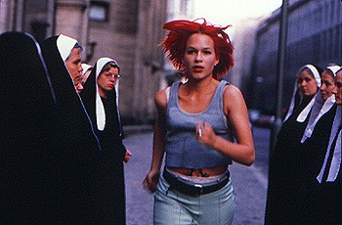
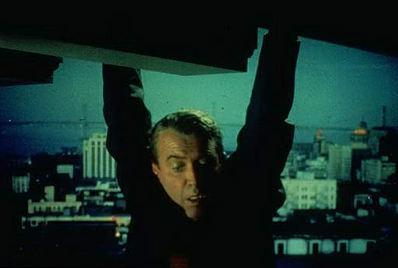


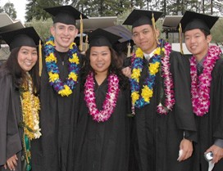























Why study computer vision?
Vision is useful: Images and video are everywhere!
Personal photo albums
Movies, news, sports
Surveillance and security
Medical and scientific images

Slide 28




Special effects: shape and motion capture
Source: S. Seitz

Slide 29

3D urban modeling
Bing maps, Google Streetview
Source: S. Seitz

Slide 30

3D urban modeling: Microsoft Photosynth
http://photosynth.net
Source: S. Seitz

Slide 31

Face detection
Many digital cameras now detect faces
Canon, Sony, Fuji, …
Source: S. Seitz
Notes:
Why would this be useful? Main reason is focus. Also enables “smart” cropping.

Slide 32
Smile detection
Sony Cyber-shot® T70 Digital Still Camera
Source: S. Seitz
Notes:
Take a picture in the perfect moment

Slide 33

Face recognition: Apple iPhoto software
http://www.apple.com/ilife/iphoto/

Slide 34




Biometrics
How the Afghan Girl was Identified by Her Iris Patterns
Source: S. Seitz

Slide 35


Biometrics
Fingerprint scanners on many new laptops, other devices
Face recognition systems now beginning to appear more widely iphone X just introduced face recognition

Slide 36


Optical character recognition (OCR)
Technology to convert scanned docs to text
If you have a scanner, it probably came with OCR software
Digit recognition, AT&T labs
License plate readers
http://en.wikipedia.org/wiki/Automatic_number_plate_recognition
Source: S. Seitz

Slide 37



Toys and Robots

Slide 38


Mobile visual search: Google Goggles

Slide 39



Mobile visual search: iPhone Apps

Slide 40

Automotive safety
Mobileye: Vision systems in high-end BMW, GM, Volvo models
“In mid 2010 Mobileye will launch a world's first application of full emergency braking for collision mitigation for pedestrians where vision is the key technology for detecting pedestrians.”
Source: A. Shashua, S. Seitz

Slide 41

Vision in supermarkets
LaneHawk by EvolutionRobotics
“A smart camera is flush-mounted in the checkout lane, continuously watching for items. When an item is detected and recognized, the cashier verifies the quantity of items that were found under the basket, and continues to close the transaction. The item can remain under the basket, and with LaneHawk, you are assured to get paid for it… “
Source: S. Seitz

Slide 42

Amazon Go

Slide 43


Vision-based interaction (and games)
Sony EyeToy
Microsoft’s Kinect
Assistive technologies
Source: S. Seitz

Slide 44


Augmented Reality

Slide 45


Virtual Reality

Slide 46

Vision for robotics, space exploration
NASA'S Mars Exploration Rover Spirit captured this westward view from atop a low plateau where Spirit spent the closing months of 2007.
Vision systems (JPL) used for several tasks
Panorama stitching
3D terrain modeling
Obstacle detection, position tracking
For more, read “Computer Vision on Mars” by Matthies et al.
Source: S. Seitz

